Slide 1
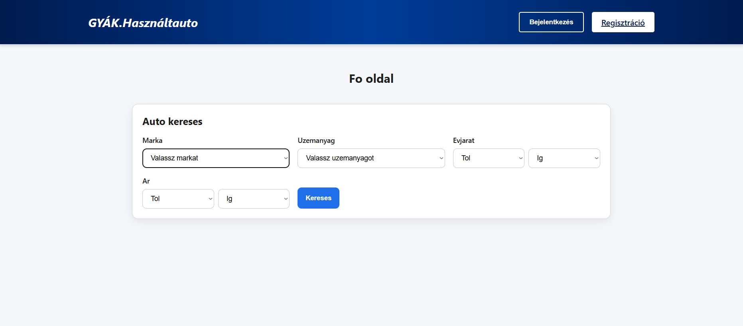
GYÁK.Usedcar marketplace
Made by: Kovács Dominik, Anda Ákos, Farkas György

Slide 2
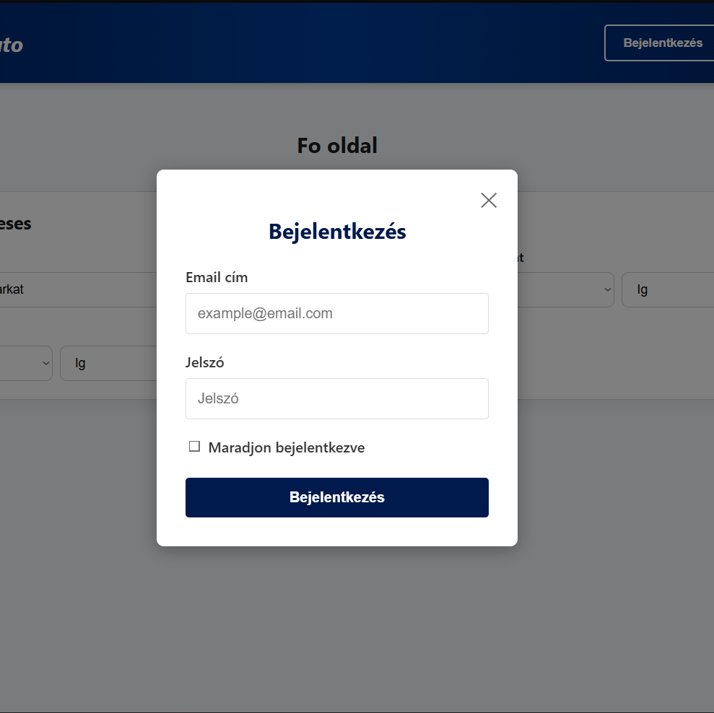
Why this project was made:
We are making this project to solve an existing issue with the used car marketplaces. Most of the cars in those listings are just junk.
We aim to make the used car marketplace better.
Our aim is to stay ad and scam free.

Slide 3
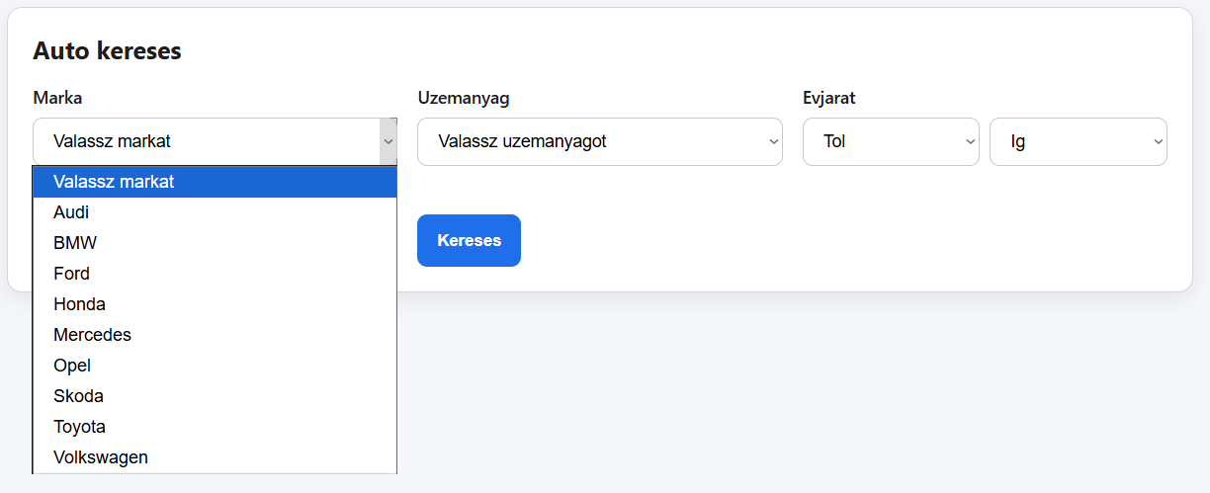
Project requirements
Functional requirements:
Account logins for all users, Database for all cars and users
Non-functional requirements:
Ease of use for the average user, Fast loading across all pages, Secure database

Slide 4
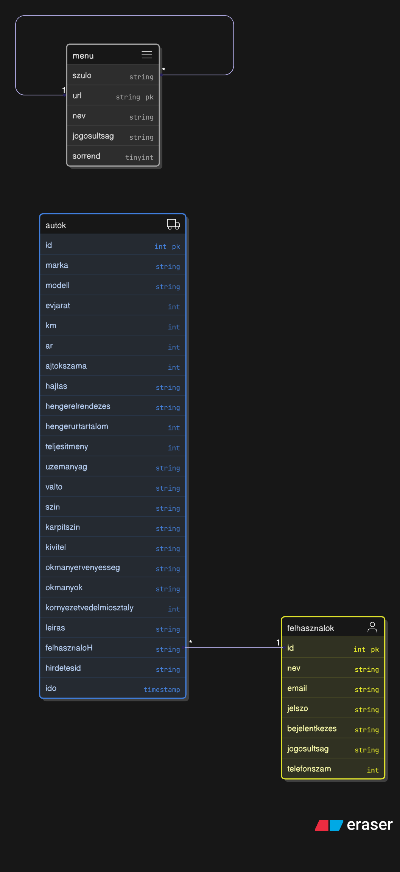
Database design
ER diagram:
Modern PHP based database
Distinc use of Foreign keys and primary keys for a better structure.

Slide 5
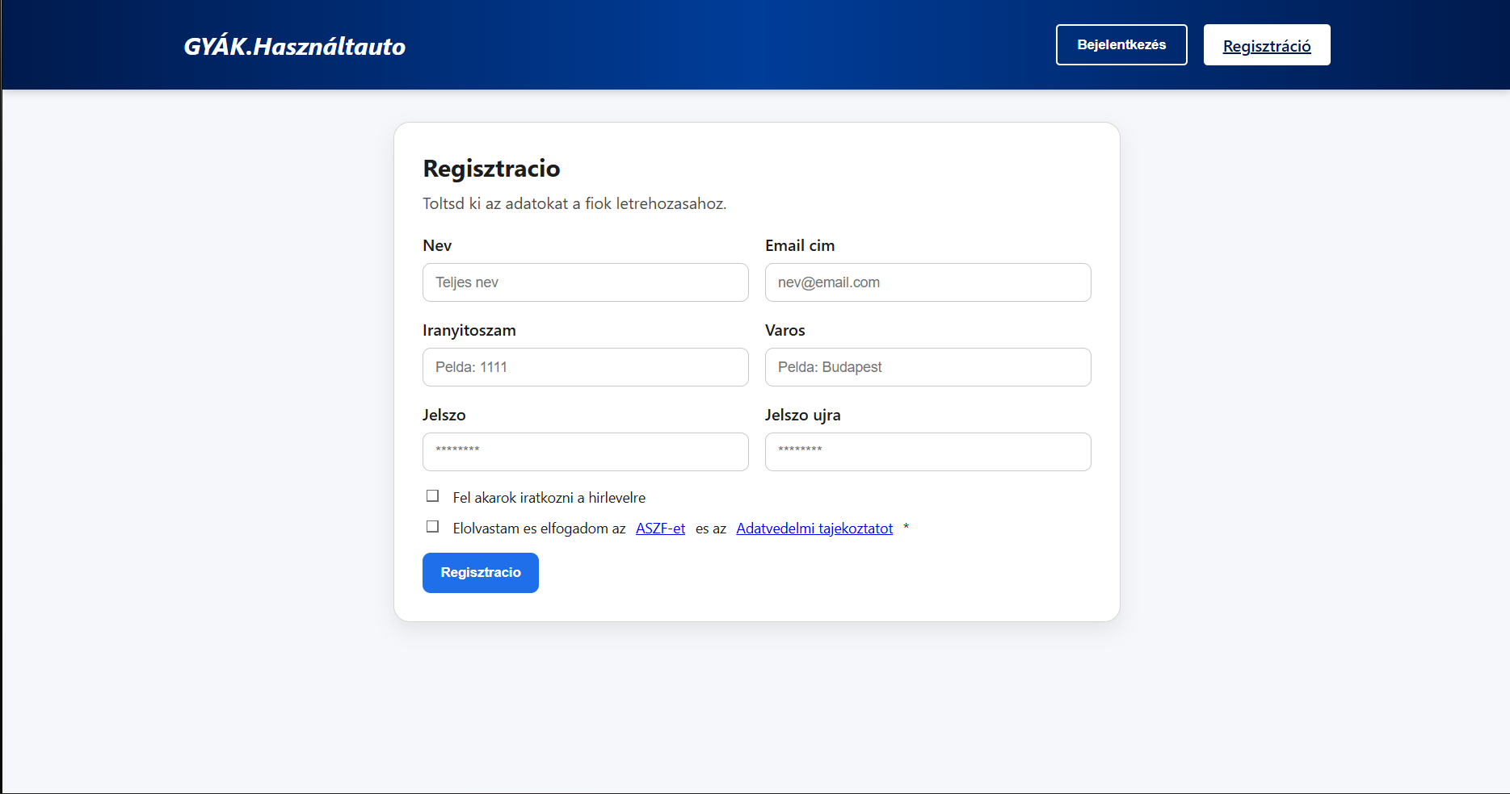
System architecture
Frontend:
React Js
Javasctipt (ES6+)
HTML5, CSS3
Backend
PHP
Rest API
Database
MySQL
Development tools(A.K.A. honorable mentions ig..) Visual Studio Code, Github, XAMPP

Slide 6
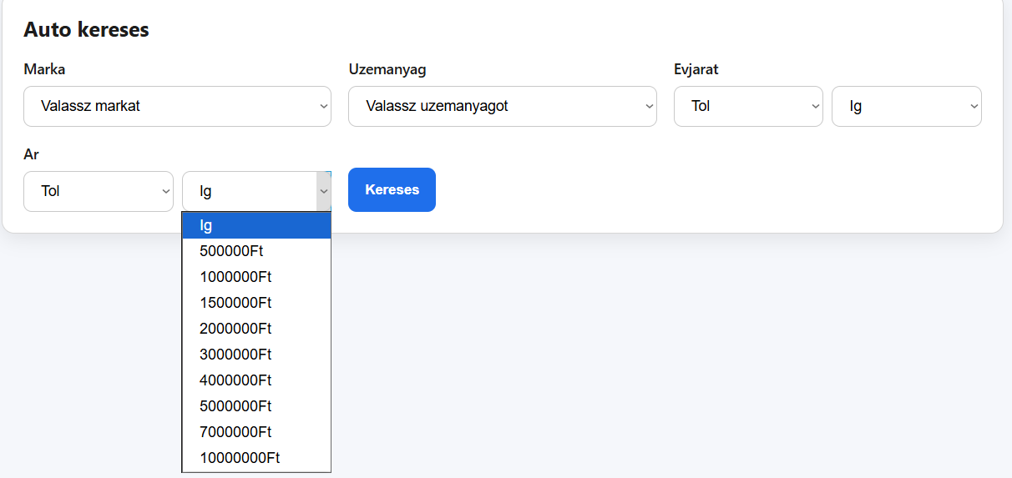
User Interface
Easy to use, easy to understand writing style.
Made for all ages from Teenagers who are infront of purchasing their first car, to Elders who wish for a better car than their current.
Multi-criteria search functionality was implemented, enabling filtering by brand, price range, type, and model year.

Slide 7
Future Improvements
We aim to add an AI based assistant made to help people pick the best car for their needs.
We would also like to add a navigation bar to the site for later improvements.
New, Improved security features that are futureproof.
Scalability: We want to spread across to all platforms
We want to outgrow being only a website.
In the future we plan to have a mobile application, and also a computer application across platforms.

Slide 8
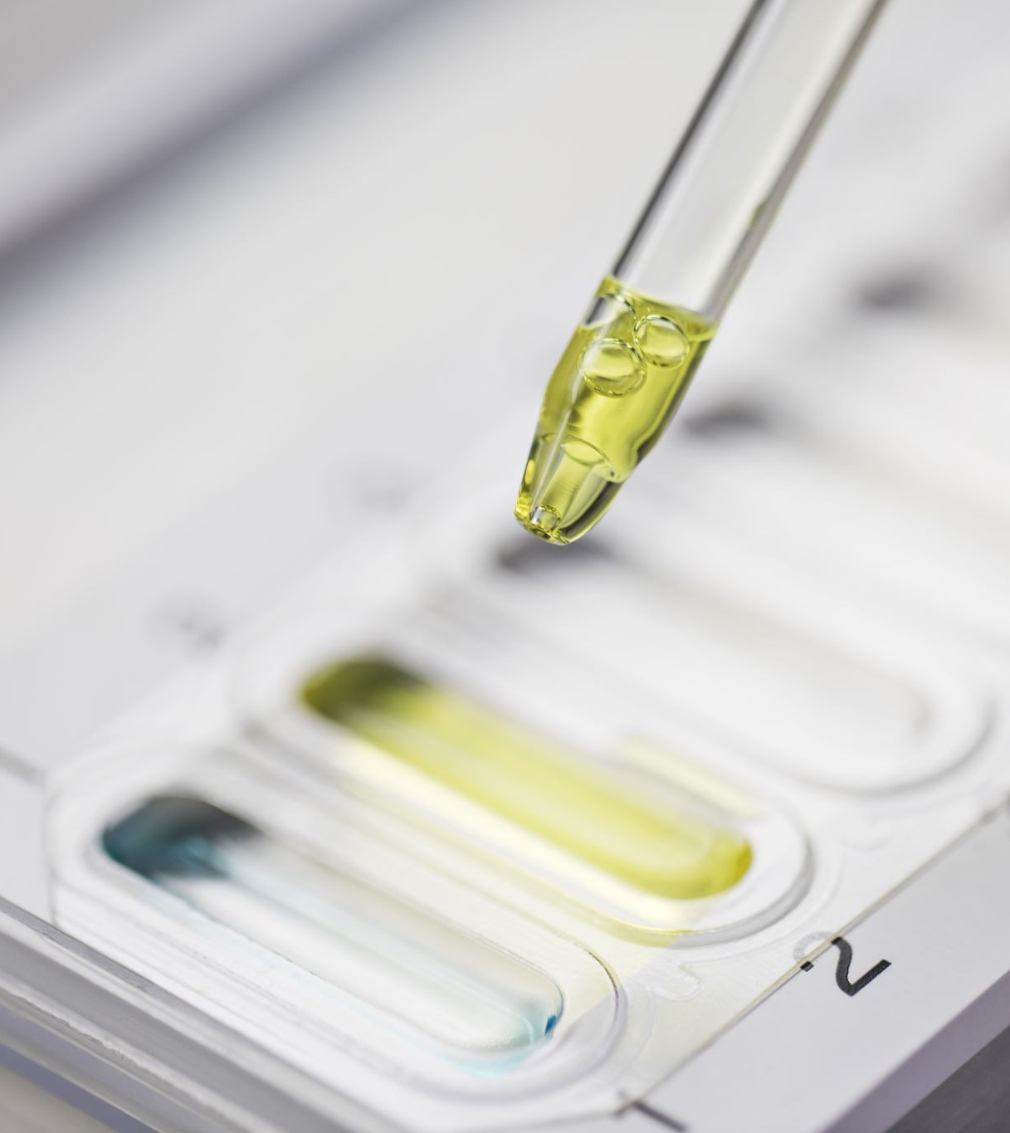
Testing
We used various forms of testing such as white box testing.
We also stress tested the site very very much.
Fixed multiple bugs that appeared on the main page
Fixed known login issues to appearing on older accounts

Slide 9
Summary of our project so far
We still have a long way to go, but!
The main page is already done.
Login page was implemented successfully.
Registration page was implemented fantastically
We gained so much experience together working on this project.
Such as: Learning to work in teams, having tons of workload under constant pressure and fear.
Also php

Slide 10

Thanks for watching 😎
Gobbless

